Slide 1
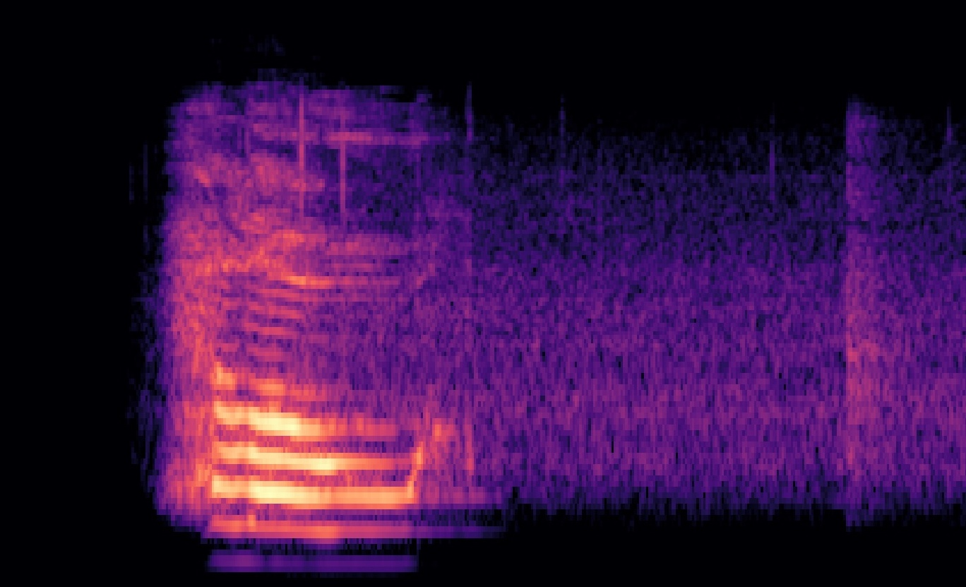


MISOPHONIA FILTER
Albert Janzen & Anvar Khujakulov & Axel Nordfeldt
December 15, 2020

Slide 2
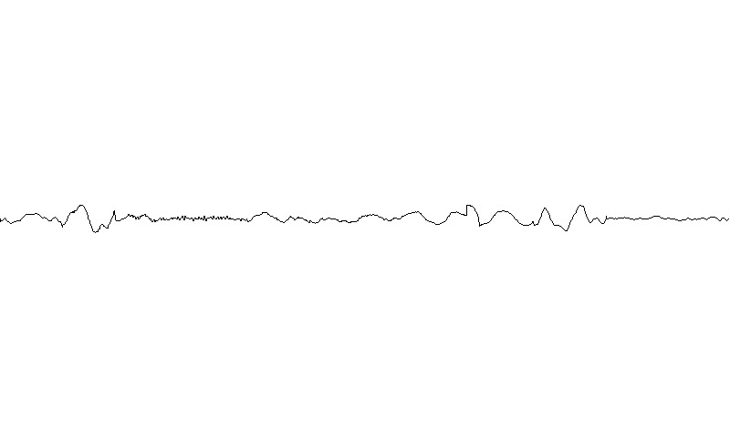
contents
1 What is misophonia?
2 A project description
3 How did we approach the problem?
4 The applied machine learning technique
5 Limitations of the project
6 Scope for improvement

Slide 3

Miso- (“hatred”) +‎ -phonia (“sound”)
misophonia is a proposed neurological condition, where particular sounds elicit a strong emotional response, e.g. hate, anger, anxiety, rage, panic, physiological distress.
The most common triggering sounds are oral sounds such as
chewing
smacking,
speaking with a dry mouth
swallowing

Slide 4


Slide 5
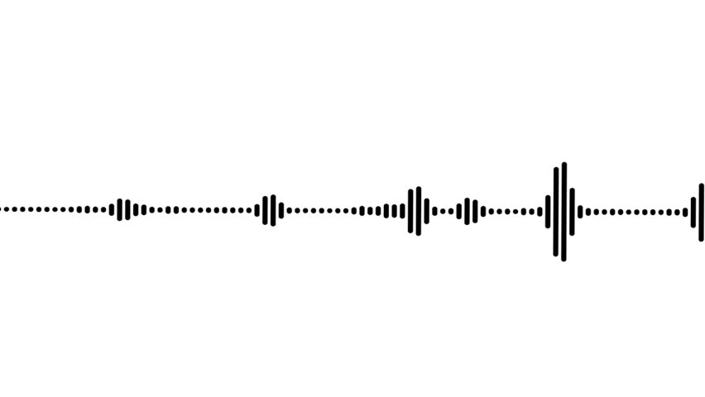
why talking about misophonia?
up to 20% of the population may have some degree of misophonia
it impacts the lives of both people with misophonia and the people around them
the role of machine learning
there are no evidence-based methods for treatment
machine learning can help filtering out particular sounds

Slide 6

The Misophonia Filter
is a device on your computer, on your phone and even in your ear that filters particular sounds. For this, a machine has to learn to
classify “disgusting” sounds,
recognize the start and the end of these sounds and
predict whether such a sound will appear in the future, e.g. in 2 milliseconds
The device then filters out the sounds by cancelling out the relevant frequencies.

Slide 7
the approach
start with step 1, making a machine recognise whether or not there is a “disgusting” sound in a given video.
step 2 and step 3 depend on the success of step 1
collect and label data in two different approaches:
1 label data manually
2 use different sources for positive (with “disgusting” sound)
and negative class (without “disgusting” sound)

Slide 8
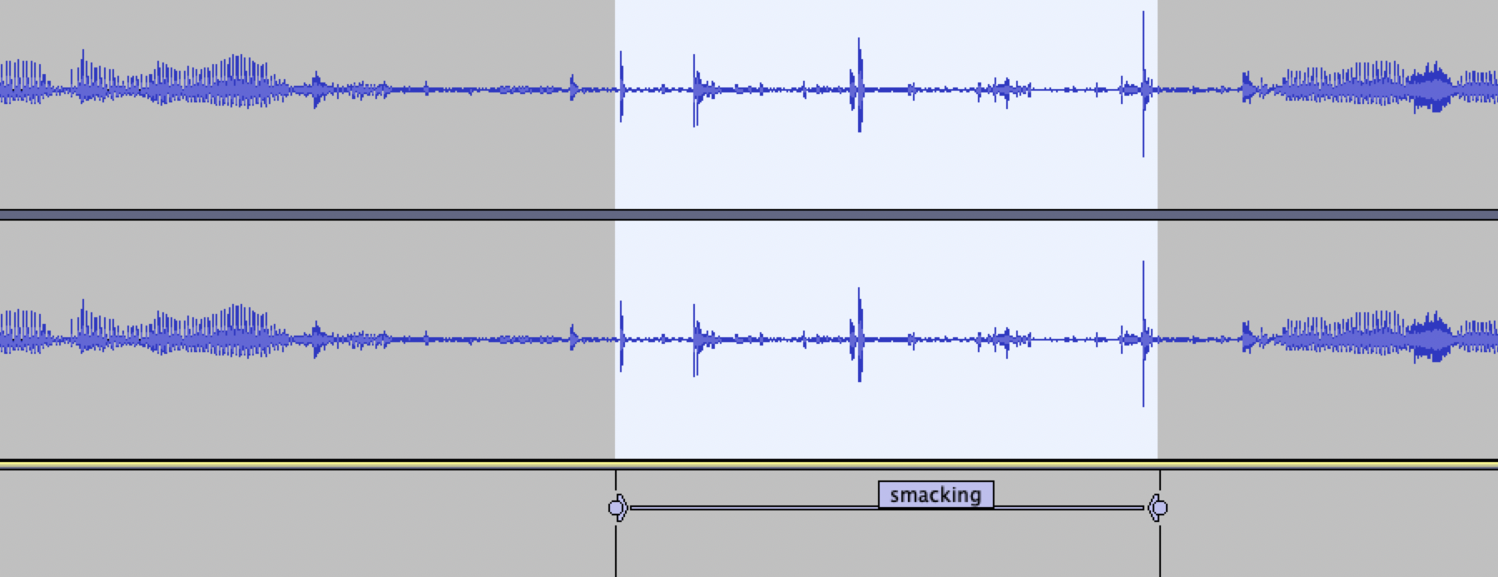
approach 1
listen to a lot of videos and label the start and the end of each “disgusting” sound

Slide 9
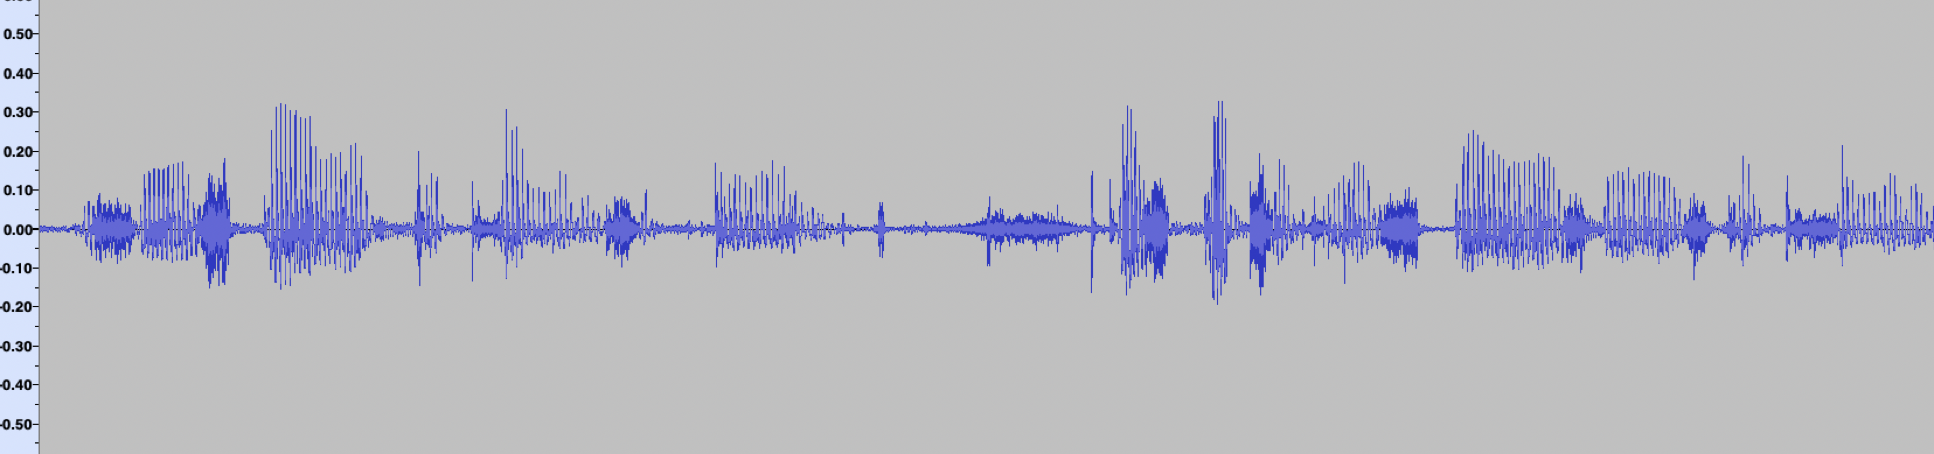
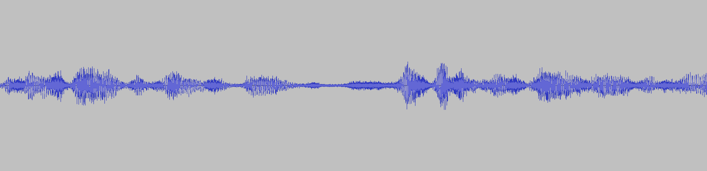
approach 2
slice up videos containing only “disgusting” sounds
apply data augmentation

Slide 10
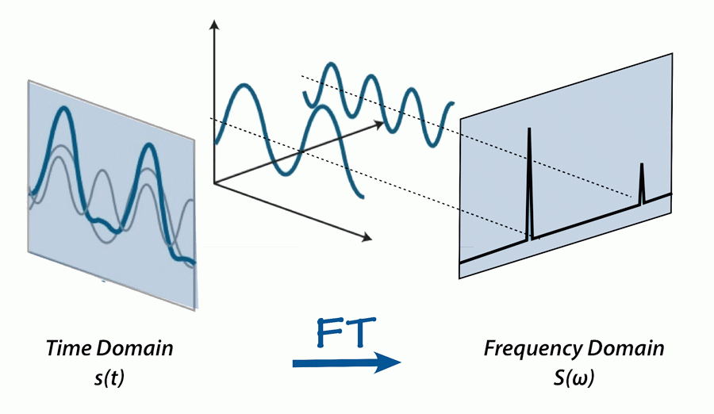
processing the data
audio files are stored as a series of numbers, where each number denotes the amplitude at a point in time
with a Fourier-Transformation, the underlying frequencies can be detected

Slide 11
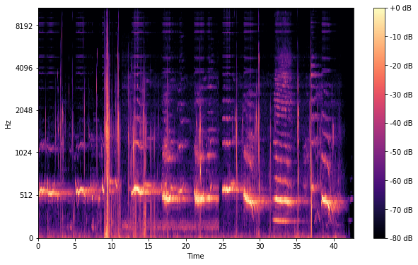
the Mel-Spectrogram
shows the amplitude of each frequency at each point in time

Slide 12
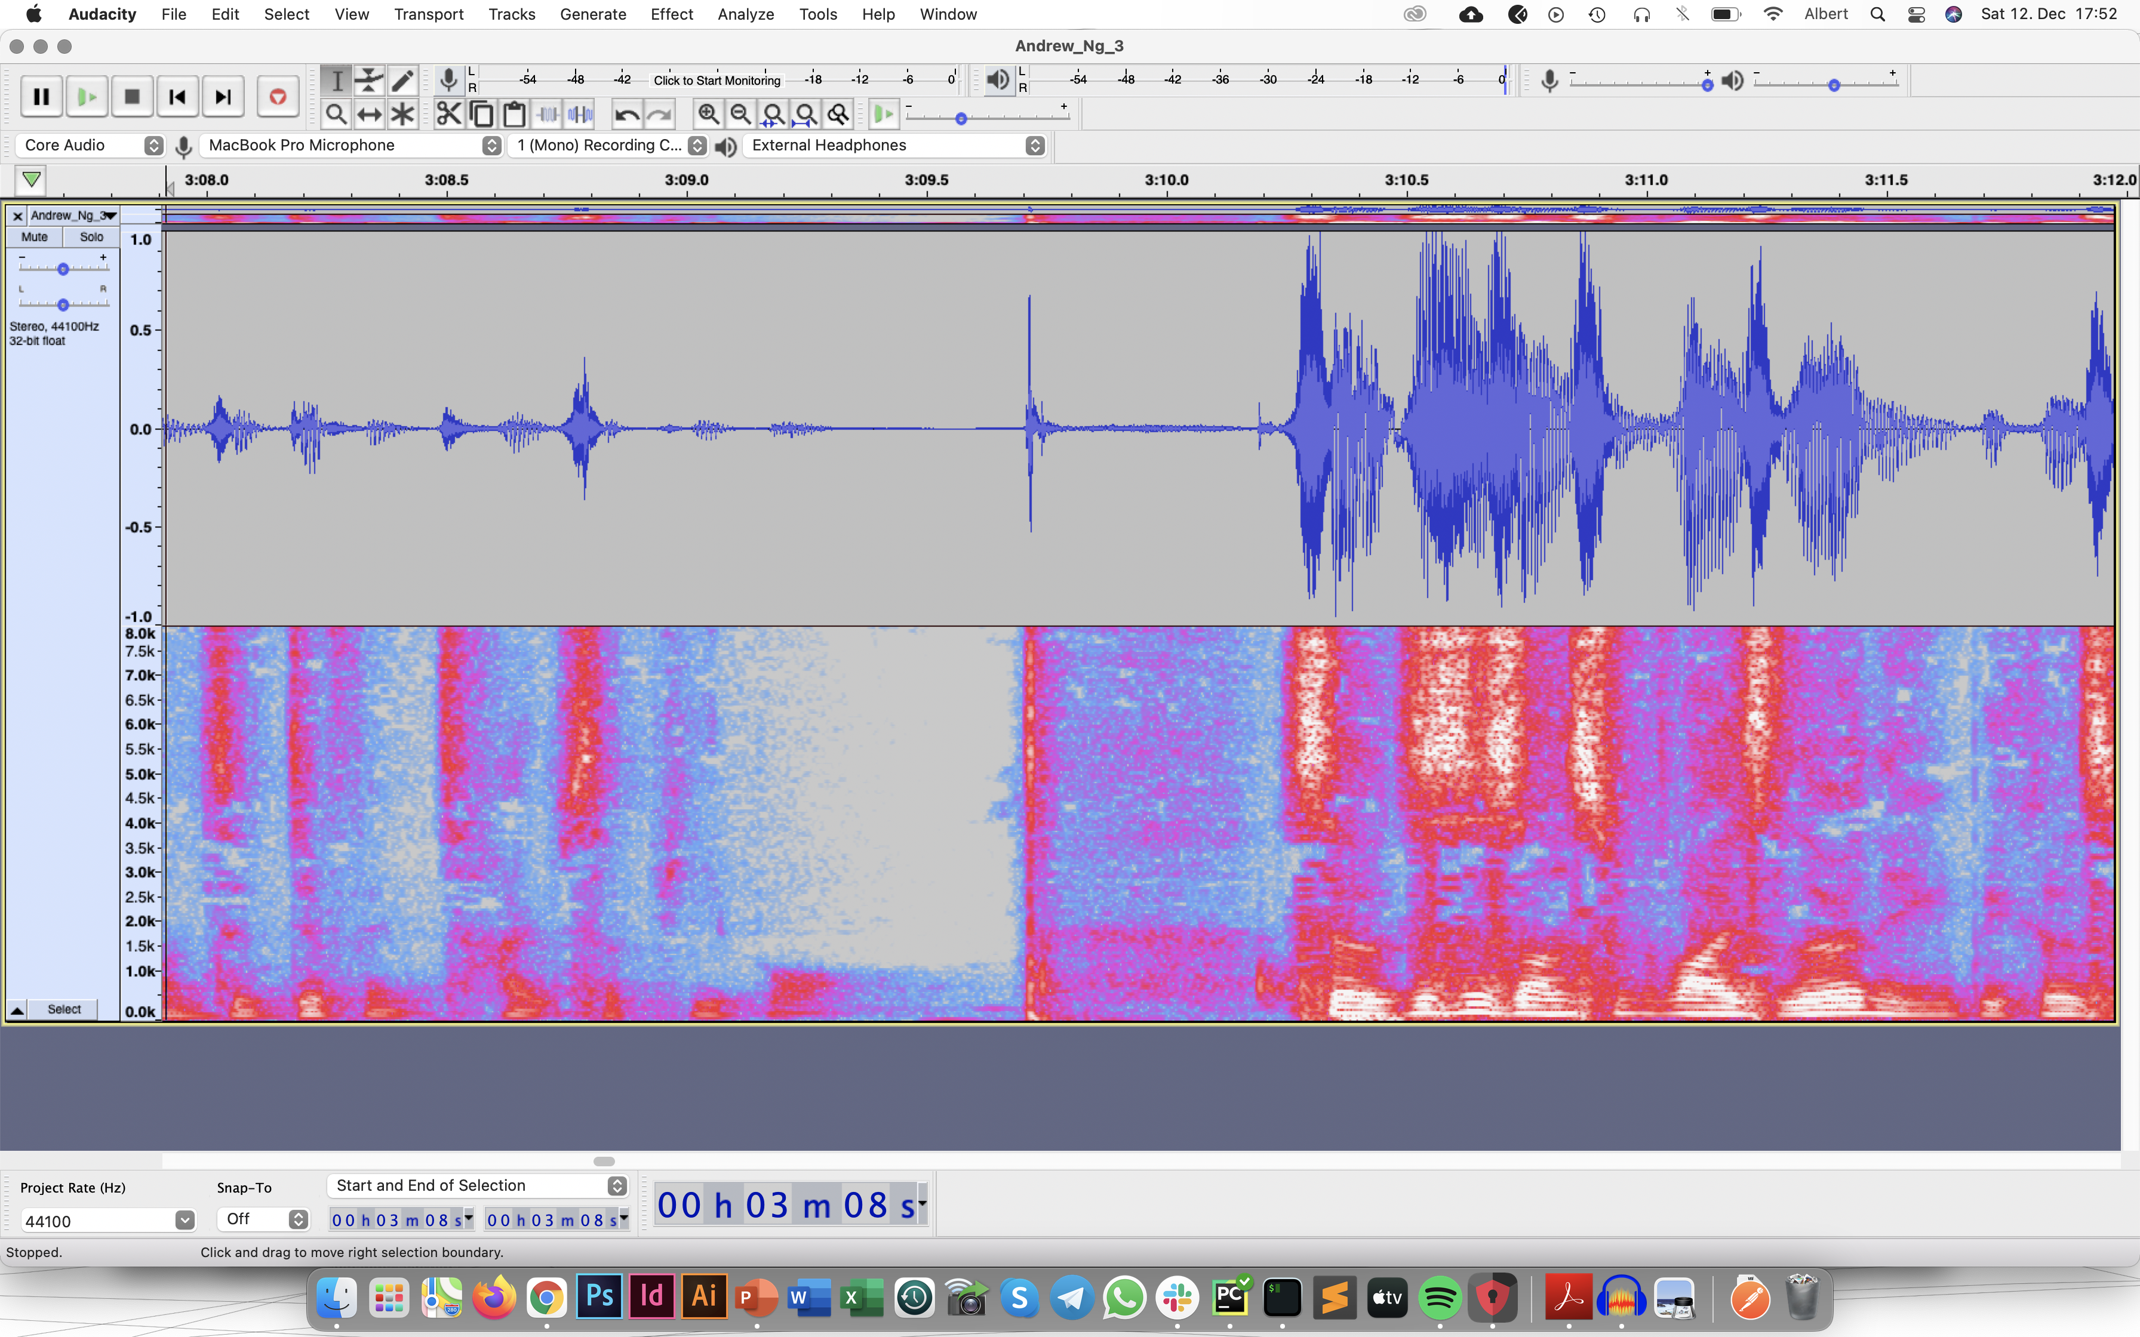

the machine learning technique
one can detect patterns in the Mel-Spectrogram
using a convolutional neural network (CNN)

Slide 13
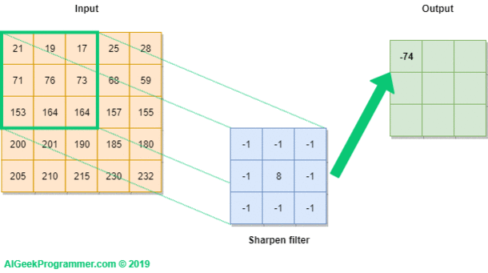
how do CNNs work?

Slide 14
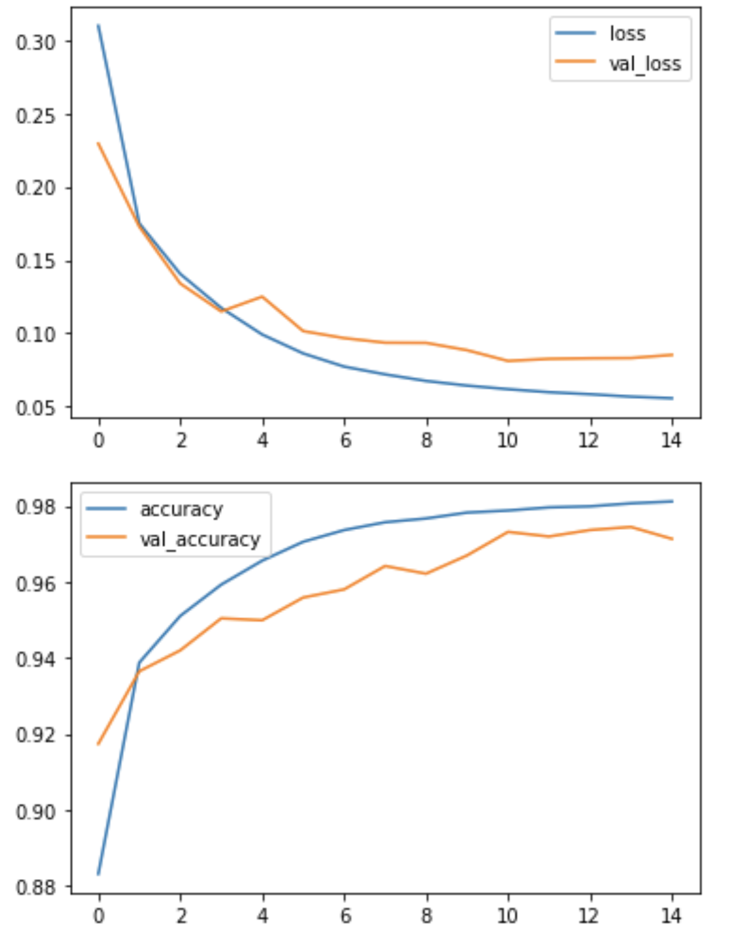
results
a CNN with one 2-dimensional convolutional layer yields the best results:
validation accuracy > 97%

Slide 15
limitations
collecting enough data that represents the variety of triggering sounds in all the different ways to record them
predicting the sounds in advance depends on there being clues that humans might not pick up

Slide 16
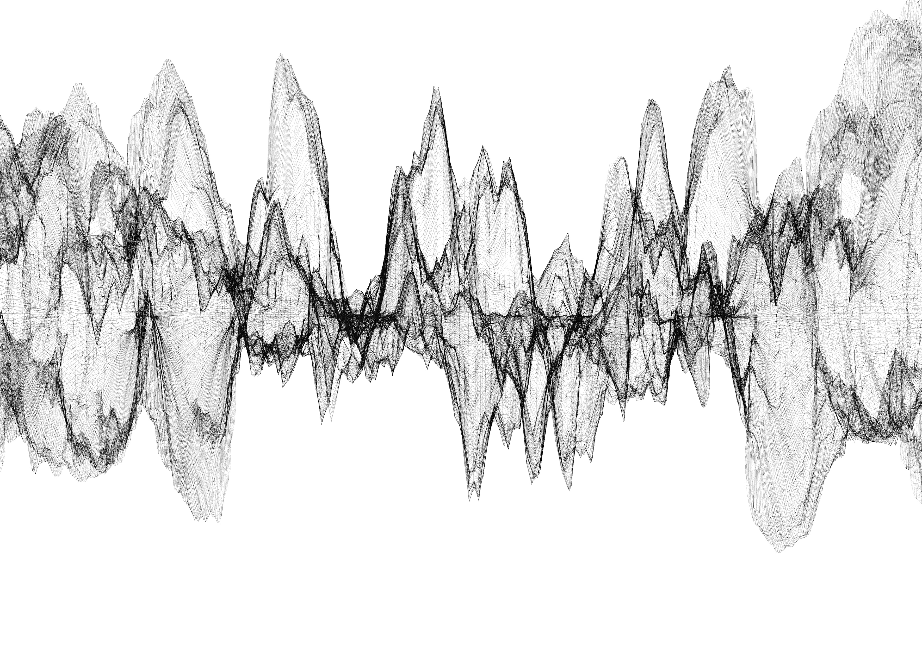
scope for improvement
given a lot more data, a filter applied to videos online is very likely
given more data, the multiple classes can be trained allowing for more customized filtering
given more time, the manual labelling approach can be used and achieve even higher accuracy
reach out to: janzen.albert@gmail.com or find me on www.linkedin.com/in/albertjanzen

